Slide 1

A Human-in-the-Loop Approach to Decision Tree Building
By Zainab Aslam

Slide 2
Project Background
Decision trees are widely-used, from business market analysis, to healthcare, medicine and finance to make critical decisions (Hogarty, 2022).
Requires large amounts of data, evaluating decisions becomes much more complex especially without domain knowledge
Users can create effective models for their domain, and gain a deeper understanding of the data to aid pattern recognition
User interaction and interpretable visualisations can support those with less machine learning expertise
Must balance accuracy and interpretability, and consider generalisability, robustness and comprehensibility (Gleicher, 2016; Muhlbacher et al., 2018).

Slide 3
Existing Applications
BaobabView: Interactive construction and analysis of decision trees
Van den Elzen and Van Wijk (2011)
Presents an application allowing users to interact, construct and analyse decision trees.
Provides multiple visualisations in the form of tree-map, streamgraph and a confusion matrix
Understanding the Forest: A Visualization Tool to Support Decision Tree Analysis
Maçãs, Campos and Lourenço (2023)
Represents a decision tree forest
Developed a visual tool that provides multiple views incorporating summary views on the random forest, correlation grids and pie charts for a complete view of the model.

Slide 4
This Approach
Uses Streamlit to host the project as a dynamic, multi-page web application and to handle user interactions through widgets
Allows a user to perform regression and classification tasks
Uses dtreeviz visualisations to represent the tree structure
Uses scikit-learn’s DecisionTreeClassifier and DecisionTreeRegressor to display relevant plots, providing interpretability to the configured model
Provides warnings and suggestions to help avoid overfitting and underfitting

Slide 5
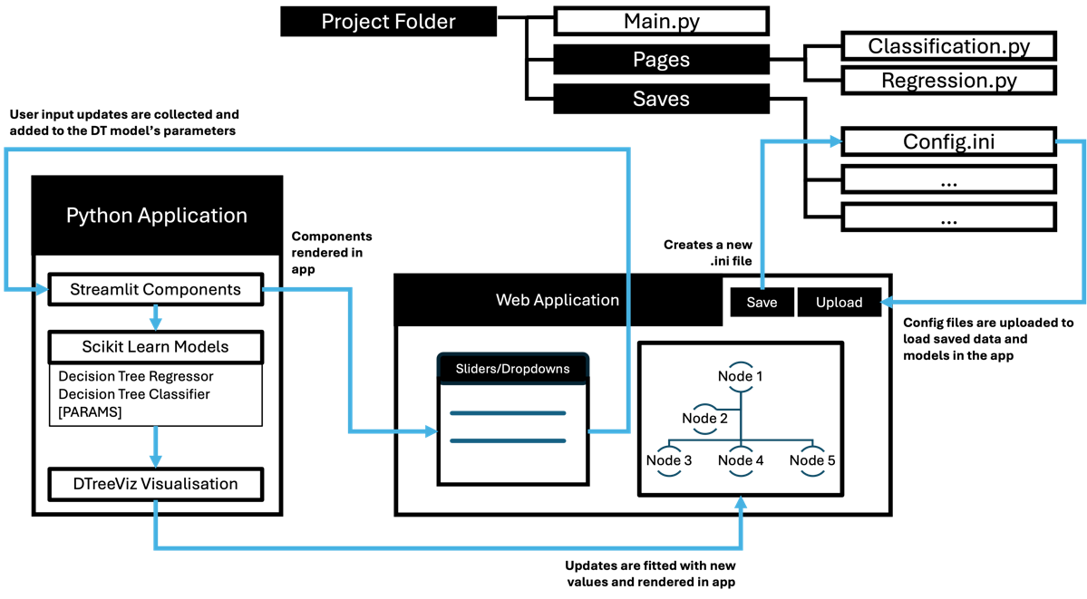
Technical Architecture

Slide 6
Features – Both Models
CSV File upload
Target Column dropdown
Sliders: max_depth, min_samples_split, min_samples_leaf, test_size
Dropdown: criterion, split type
Feature Selection
Cross Validation with choice of scoring metric used, k-fold slider
Feature Importance
Cost Complexity Pruning
GridSearchCV
Save / Upload Configuration

Slide 7
Features – Classification Model
Target column – displays ‘categorical’ features as options
Data Analysis – Feature Scatterplot Analysis (user is given the option to change X and Y axis)
Scikit-learn DecisionTreeClassifier
Scores – Balanced Accuracy, Generalisation score to help detect overfit
Confusion Matrix

Slide 8
Features - Regression Model
Target Column dropdown – displays ‘numerical’ features as options
Data Analysis
Boxplot
Correlation Matrix using Phi – K
`Scikit-learn DecisionTreeRegressor
True vs Predicted Values plot
Scores (mean absolute error, a CV threshold is created to help detect overfit and underfit)
SHAP Analysis
Partial Dependency Plot

Slide 9
Demo

Slide 10
Validation Testing
Testing the usability against design outcomes and user expectations
Upload configuration feature - Once this was uploaded, the user could not restart the page by changing the CSV file, configuration files were still saved.
Wine Quality dataset - high max_depth values caused incompatibility with the dtreeviz library for both the classification and regression model.
Iris dataset - f1, precision and recall scoring types returned nan values for each score. These methods are not intended to be used for multi-class classification scoring,
Some regression models struggled to determine an underfitting model through the mean absolute error.

Slide 11
Performance Testing
Load times increased for both Classification and Regression Models with larger max_depth values
Regression Models have a larger load time

Slide 12
Limitations + Future Work
The dtreeviz library - at times does not support Streamlit visualisations of the SVG file
Max_depth size and dataset size increased the load times significantly - web-based applications should not have large load times.
Use of Streamlit’s caching feature and expander widgets could avoid whole page re-rendering and reduce information overload for the user.
Labelling overfitting and underfitting in the model may need to be refined. Thresholds should consider the dataset size for further accuracy regarding user aid. Further research could develop the detection of overfitting within regression, specifically using the scoring metrics.
Refinement of the model building pipeline – include extensive EDA and data cleaning functionality
Error handling regarding config upload and CV scoring

Slide 13
Summary
There is promise in incorporating user domain knowledge within the model pipeline. The user can configure parameters for the decision tree model and interpret the impact of each feature on the model outcome.
Users are given the ability to select features, perform a grid search to identify best model parameters, as well as prune their configured dataset to combat overfitting within the data.
This application could be better used for smaller datasets to provide an example of how interactive decision tree builders can be created for regression and classification models as a web-based application.

Slide 14
References
Hogarty, S. (2022) Decision trees: Definition, analysis, and examples, Ideas. Available at: https://www.wework.com/ideas/professional-development/business-solutions/decision-trees-definition-analysis-and-examples.
Gleicher, M. (2016) ‘A Framework for Considering Comprehensibility in Modeling’, Big Data, 4(2), pp. 75–88. Available at: https://doi.org/10.1089/big.2016.0007.
Muhlbacher, T. et al. (2018) ‘TreePOD: Sensitivity-Aware Selection of Pareto-Optimal Decision Trees’, 24(1), pp. 174–183. Available at: https://doi.org/10.1109/tvcg.2017.2745158.
van den Elzen, S. and van Wijk, J.J. (2011) ‘BaobabView: Interactive construction and analysis of decision trees’, 2011 IEEE Conference on Visual Analytics Science and Technology (VAST) [Preprint]. Available at: https://doi.org/10.1109/vast.2011.6102453.
Maçãs, C., Campos, J.R. and Lourenço, N. (2023) ‘Understanding the Forest: A Visualization Tool to Support Decision Tree Analysis’, 2023 27th International Conference Information Visualisation (IV) [Preprint]. Available at: https://doi.org/10.1109/iv60283.2023.00047.

